Slide 1
THE
PROTESTANT
REFORMATION
Created by: Lisa Sydeski Thomas Jefferson High School
Pittsburgh, PA

Slide 2
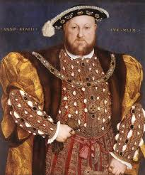
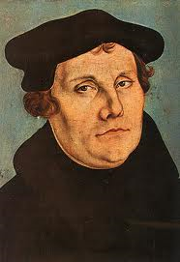
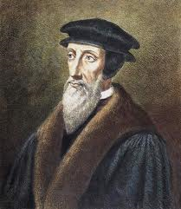
THEMES
Irrevocable split in the RCC b/w Catholic and Lutheran
Eventually Protestants split into many different sects
Three flavors:
Protestant Reformation
English Reformation
Counter/Catholic Reformation

Slide 3
OBJECTIVES
What late medieval religious developments paved the way for the adoption and spread of Protestantism?
Why did the strictly theological ideas of Martin Luther trigger political, social, and economic reactions?
What were the consequences of the schism?
Do the various reform movements represent revolution or continuity?

Slide 4
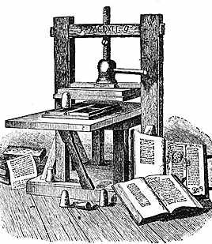
CAUSES
Political – power struggle, resentment over Church’s claim over civil authority
Economic – Church’s wealth and properties, tithe (church tax), resentment of $ flow to Rome
Intellectual – Renaissance ideas – questioning attitude – doubt religious power and authority
Technological – Printing Press

Slide 6
CAUSES
Worldliness – luxurious and materialistic lifestyles of popes and high clergy
Nepotism – appointing relatives to Church positions to the Church regardless of ability
Simony – buying and selling of Church positions
Indulgences – accepting $ for Church pardons

Slide 7
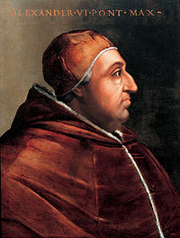
CAUSES
Clerical pluralism – holding more than one office
Clerical ignorance – many priests were illiterate
Clerical immorality – gambling, drinking, concubines of women
POPE ALEXANDER VI (1492-1503)

Slide 8
DECLINE IN PAPAL PRESTIGE
Babylonian Captivity (1309-1377) – Popes lived in Avignon under French Kings
Great Schism (1378-1417) – struggle for Church Supremacy – rival popes Avignon and Rome claim to be the true Pope (3 Popes??? Authority???)
Conciliar Movement – periodic councils, assemblies to reform the Church

Slide 9
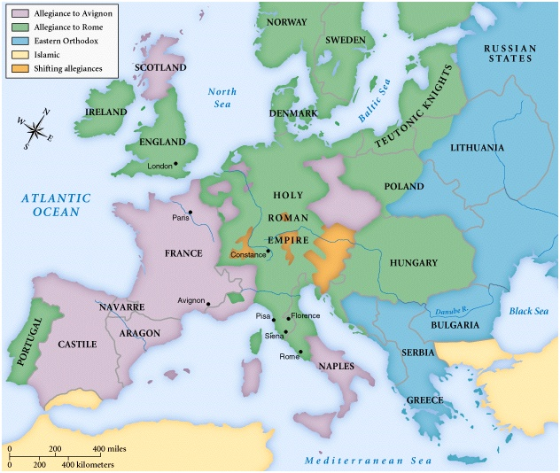
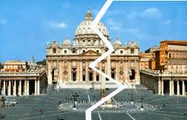

Slide 10
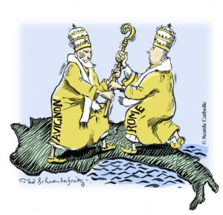
CONCIL OF CONSTANCE
1414- 1418
Three objectives
END SCHISM
WIPE OF HERESY
ELECT A NEW POPE
MARTIN V (1417-1431)

Slide 11
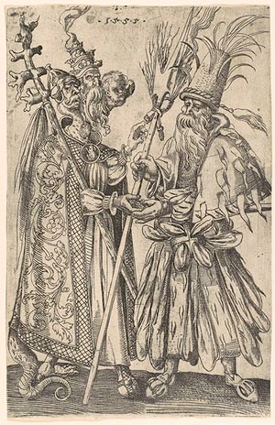
Satire on Popery
1555

Slide 12
POWER OF THE RCC
Middle Ages (500-1500) – civilizing agent
Missionaries – converted the pagan population
Hospitals – care for the sick
Cathedrals and Monasteries – centers for learning
Pope Leo III crowned Charlemagne 800 C.E. – foundations of the HRE
Papal States – Pepin the Short (714?-68) granted land to the Pope

Slide 13
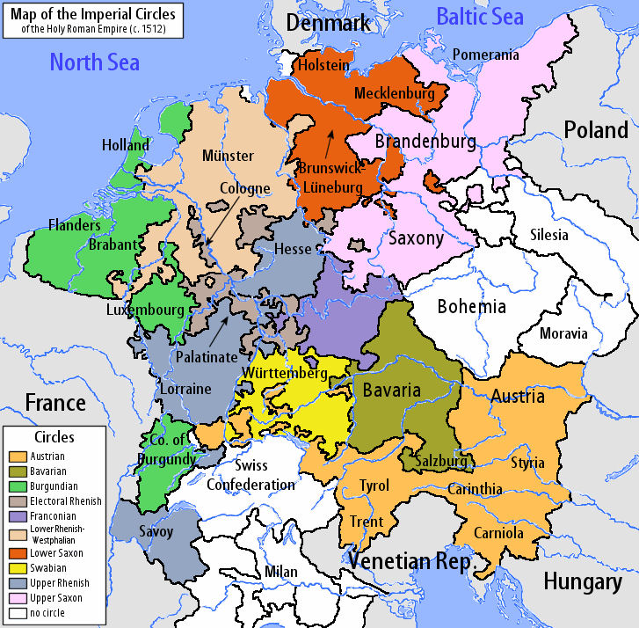
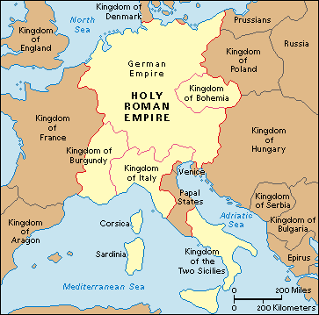
HOLY ROMAN EMPIRE
HRE – “The HRE was neither Holy, nor Roman, nor an Empire” – Voltaire
Originally Charlemagne “Emperor of the Romans”
Loose confederation of 300+ States
Holy Roman Emperor elected by 7 Elector States
Hapsburg Family – Austria – Powerful (1440-1806)

Slide 14
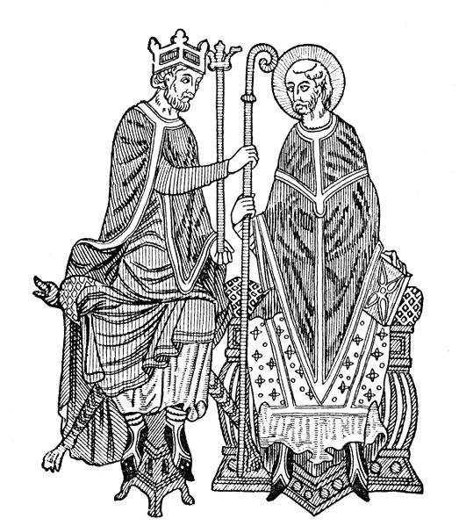
CHALLENGES TO POWER
Investiture Controversy – power struggle kings and popes during the Middle Ages
1075 Pope Gregory VII – only the Pope could name Bishops
German King Henry IV challenged the decree claiming Kings had the right to name Bishops
King Henry IV excommunicated – eventually back down

Slide 15
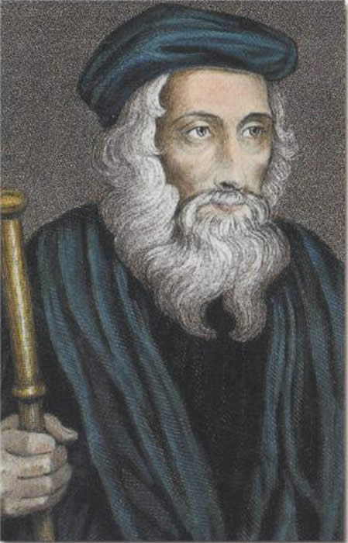
LUTHER’S PREDECCSORS
John Wycliffe (1328?-1384) – English Priest
Condemned the wealth and worldliness of the RCC
Bible highest religious authority
Translated the Bible into English
Denounced by the Pope – followers Lollards harshly persecuted

Slide 16
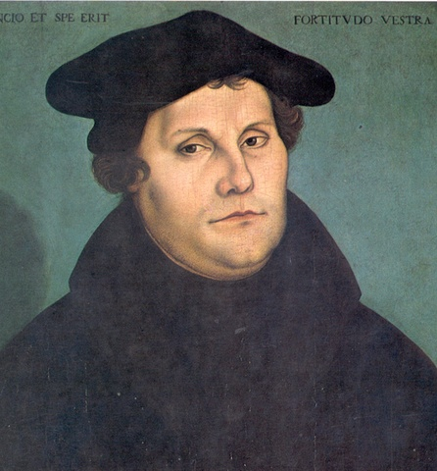
MARTIN LUTHER
Martin Luther
Great Man?
OR
Man of His Times?

Slide 17
WHY WAS LUTHER SUCCESSFUL?
Social
Political
Religious
Intellectual
Technology
Economic

Slide 18
REFORMATION THEOLOGY
Reformo – latin “to form again, mold anew, or revive”
“Scripture alone” – Bible sole authority, salvation cannot be bought and sold
“Faith alone” – Salvation through God’s grace not good works
“Christ alone” – No other mediator b/w God and humanity, rejects the hierarchy of the RCC
“Glory of God alone” – vocation
Bible translated into Vernacular (Luther’s German Bible)

Slide 19
CONSEQUENCES
End of a united Christendom
Brutal, bloody wars of religion, religious persecution
Religious, Social, Political conflicts intermingled
Emphasis on education – establishment of modern languages (German, English) not Latin
Confiscation of Church lands increased power for rulers
New emphasis place on family and marriage

Slide 20
CONSEQUENCES
Counter Reformation – RCC reaffirmation of traditional Catholic theology
Growth of Capitalism – material success a sign of Grace, moral discipline, and individualism
Italy, Spain, Austria, Hungary, Poland, S. Germany (Catholic)
N. Germany, Baltic region (Lutheran)
Scotland, Switzerland, Holland (Calvinist)
England (Anglican)

Slide 21
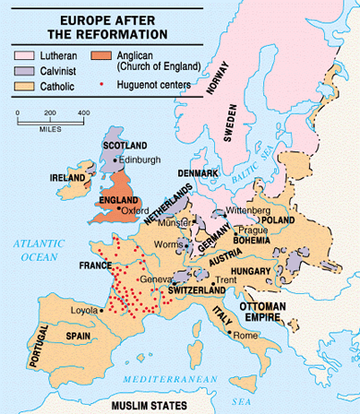

Slide 22
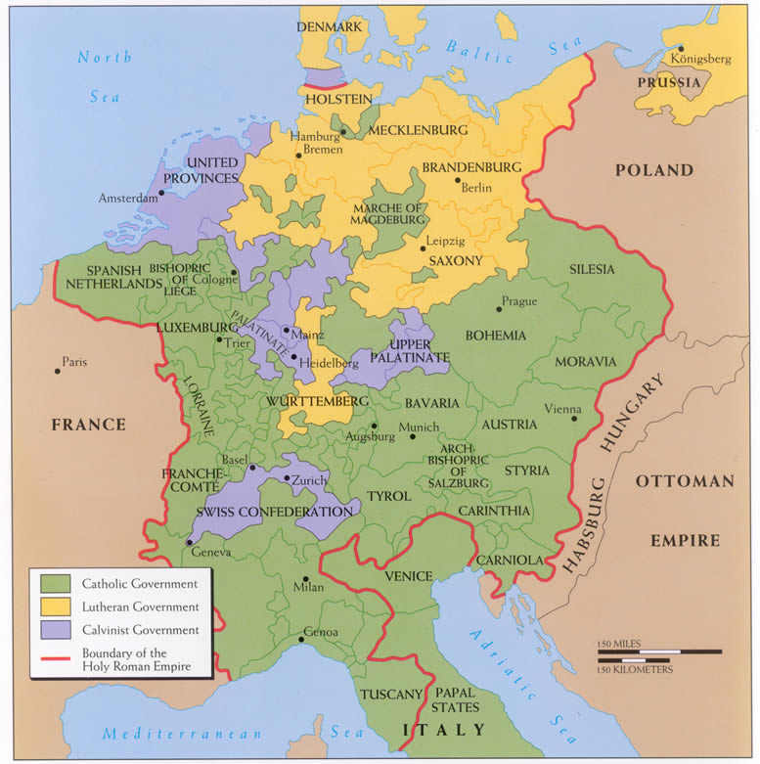

Slide 24
CONSEQUENCES
DID LUTHER SAVE OR DESTROY THE RCC?

