Slide 1
Enlightened Despotism

Slide 2
Utilitarian Arguments
Theory of strong monarchies based on divine right continued into the 18th century
Utilitarian arguments allowed monarchs to keep their power
Included:
  Maintenance of the laws
  Enforce justice
  Prevent corruption
  Defend against enemies

Slide 3
Enlightened Despotism
Natural laws & rights were influential on the monarchs of this time
Philosophes encouraged natural rights & laws but did not trust government to the common people (Reform starts with the king)
Enlightened Rulers gave people direction
Must enforce:
  Natural rights
  Encourage art, science & education
  Enforce the law equally

Slide 4
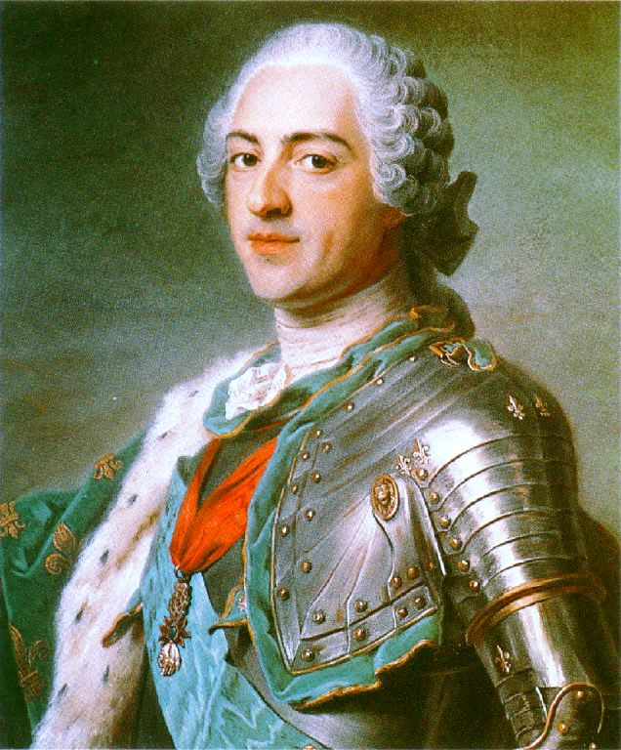
Louis XV
Louis XIV left France in debt and with a 5 year old great grandson to rule them
Louis XV was a weak ruler that was influenced by ministers & mistresses
Madame de Pompadour influenced the king enough to make government decisions & advise him on appointments and foreign policy

Slide 5
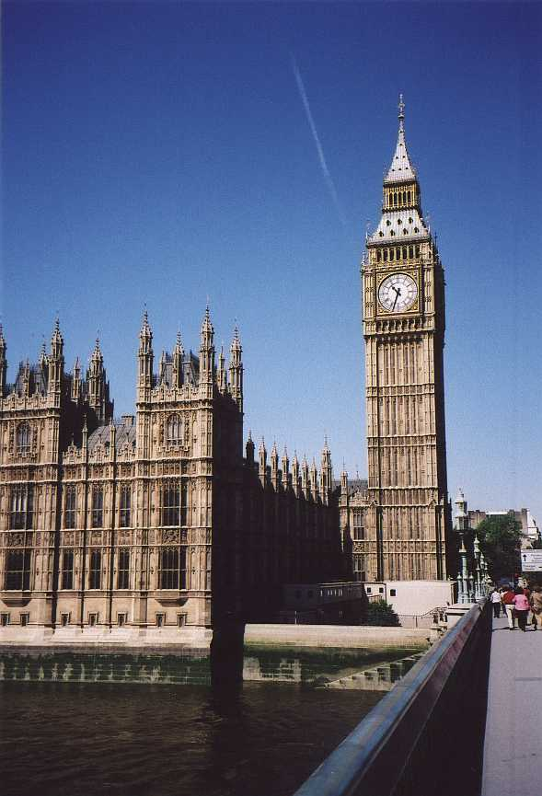
Parliament
Members of Parliament were elected
But the past history of a county or borough determined the number of representatives it would have instead of the number of people that actually lived there

Slide 6
English Parliament
Parliament was slowly gaining power over the king, though they officially shared it
Made laws, levied taxes, passed budgets and tried to influence the king’s ministers
Dominated by the landed aristocracy in both the House of Lords and the House of Commons

Slide 7
English King
Chose ministers to set policies and guidelines for Parliament
Aristocracy often fought with themselves allowing the king to gain supporters in Parliament and control what happened

Slide 8
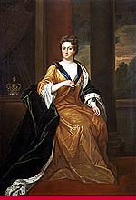
Anne Stuart
Queen Anne failed to have children
The throne was given to the Protestant rulers of the German state, Hanover

Slide 9
Hanovers
George I & George II relied on Robert Walpole, the first prime minister, to handle Parliament for them
They didn’t speak English and didn’t understand the system of government
This is the beginning of the modern cabinet system that exists in Britain
William Pitt, the elder, became PM in 1757, but was dismissed by King George III

Slide 10
The John Wilkes Disaster
Journalist and MP, John Wilkes, criticized the king
  He was removed from Parliament
  Won another seat on Parliament
  Wasn’t allowed to serve
  Led to calls for reform
  Caused George III to make William Pitt, the younger PM

Slide 11
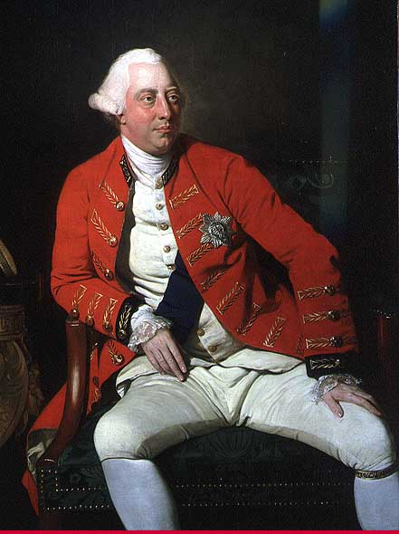
King George III
The king used patronage to win support in Parliament
His bouts with insanity secured the power of Parliament

Slide 12
Absolutism in Prussia
Frederick William I and Frederick the Great developed Prussia’s army and bureaucracy
  Created the General Directory to centralize the government (were obedient to the king)
  Junkers were the only officers in the army (created a bond between king & nobility)
  Peasants served many years in the military
  Middle class gained prestige by becoming civil servants

Slide 13
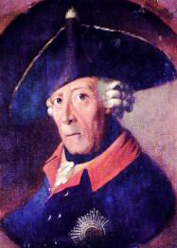
Frederick the Great
Created a single code of laws
Eliminated torture except for treason & murder
Granted limited freedom of speech & press
Granted complete religious toleration
Enlarged the Prussian army even more

Slide 14
Absolutism in Austria
Due to its size and varied nationalities had a hard time centralizing power & providing common laws
Empress Maria Theresa centralized power by having the clergy and nobility pay their property and income taxes to royal officials instead of the diets
The lands of the Habsburgs would be handled by royal officials
The military was enlarged and modernized

Slide 15
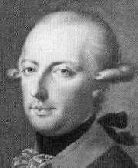
Joseph II
Abolished serfdom
Gave peasants hereditary rights to their property
Eliminated internal trade barriers and monopolies
Created a new penal code
Abolished the death penalty

Slide 16
Joseph II
Established the idea of equality before the law
Instituted religious toleration
Restricted the power of the Catholic Church
His successors undid most of his reforms

Slide 17
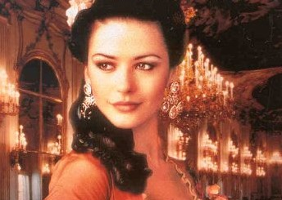
Catherine the Great
Wanted reforms but knew too many would cause the nobility to have her killed
Initially questioned serfdom, torture, capital punishment and equality of all people but implemented little change
Ended up helping the landholders

Slide 18
Catherine the Great
Gave the gentry special privileges like tax exemption & right to trial by peers – Charter of the Nobility
Serfs were forbidden to appeal to the state against their masters
Peasants revolted causing even more repression by forcing them to be serfs

Slide 19
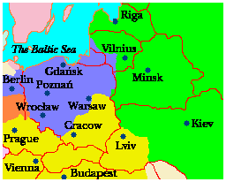
Poland
Nobles were still electing a king to do their bidding
Poland was destroyed when Austria, Russia and Prussia divided it between them as a buffer zone

Slide 20

Enlightened Absolutism
Almost every ruler in Europe pursued some reforms
Few felt they should implement those ideals completely
  Joseph II is the only enlightened despot that truly made the changes suggested by philosophes

Slide 21
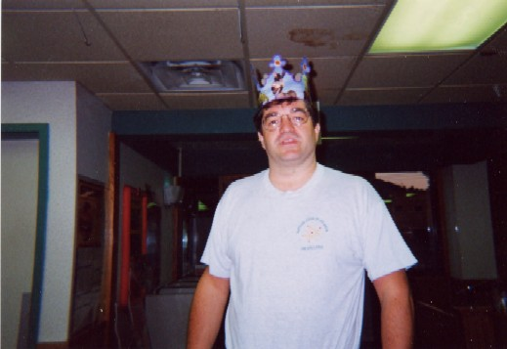
Enlightened Absolutism
Rulers more were interested in increasing their power through the development of armies and the waging of war
Because the aristocracy of Europe had so much power, it was impossible for enlightened rulers to make true reforms

Slide 22
Wars and Diplomacy
Philosophes denounced war as a waste of life and resources
Rulers paid no attention to this
  Used their governments to further their self interests
  Used wars to keep a balance of power between states
Armies were supposed to be used to protect the state
  Were often used to extend a state’s territory

Slide 23
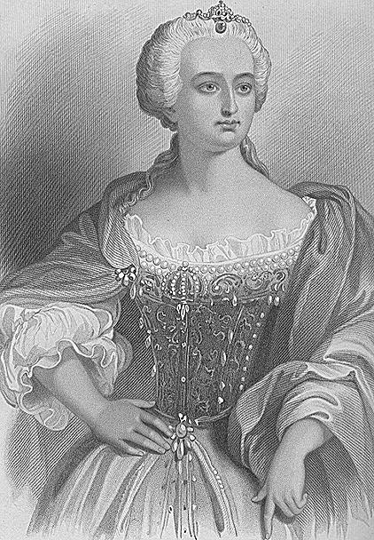
The War of Austrian Succession
1715-1740 were peaceful and diplomacy prevailed but that ended with Austrian Succession
Charles VI of Austria was unable to produce a male heir
  Leaving his daughter Maria Theresa to rule

Slide 24
Pragmatic Sanction
To ensure Europe would recognize her as a legitimate ruler they signed the Pragmatic Sanction
Charles VI died and the Pragmatic Sanction was ignored
  Frederick the Great invaded & France declared war on Austria
  Great Britain allied with Austria and war started

Slide 25

Aix-la-Chapelle
1748 – Aix-la-Chapelle
Returned all occupied land to original owners except for Silesia
  Frederick the Great of Prussia kept it
Would cause another war

Slide 26
Seven Years’ War
Started out as a war between Austria and Prussia over Silesia
Became a war between France and Britain over colonies
  Britain & Prussia vs. France, Austria & Russia
  Three areas of conflict – Europe, India & North America
War between Prussia, Austria and Russia ended with the Peace of Hubertusburg
  Austria recognized the loss of Silesia to Prussia

Slide 27
Seven Years’ War
Treaty of Paris in 1763 ended the war between France & Britain
  French withdrew from India, gave Canada to the British, gave Louisiana to the Spanish, and Spain gave Florida to the British
Britain had become the world’s greatest colonial power

Slide 28
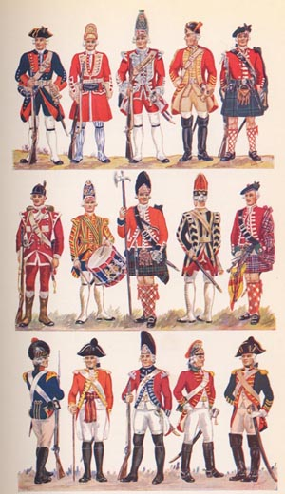
European Armies and Warfare
Professional standing armies were standard feature everywhere except Britain, who relied on mercenaries
  Officers were aristocrats
  The middle ranks were represented by the middle-class
  Soldiers came from the lowest classes

Slide 29
Russia & Prussia
Russia and Prussia conscripted their peasants
  Other countries didn’t because they needed them to farm
  Unemployed & homeless were forced to serve
  Lower class saw the army as an escape from the poor quality of their lives

Slide 30
Warfare
The increased size of warfare was no longer ideal
  No wars over religion
  Destruction of taxpayer’s money
  Generals didn’t want to risk their armies so they relied on indirect maneuvers to fight rather than direct confrontation
  Defeated armies were allowed to withdraw without being captured or destroyed

Slide 31
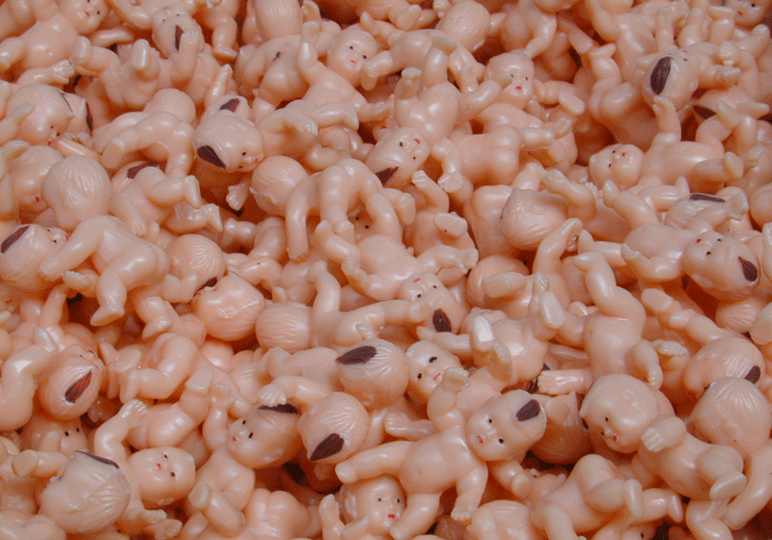
Growth of the European Population
Began to grow the second half of the century & has continued ever since
  Also, millions of people left to become colonists
  Falling death rate, lower infant mortality rate, more food for improved diets caused less famine and the end of the bubonic plague

Slide 32
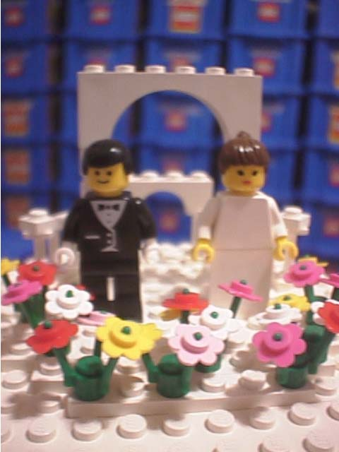
Family, Marriage and Birthrate Patterns
Families were still traditional with men remaining dominant and marriages still arranged

Slide 33
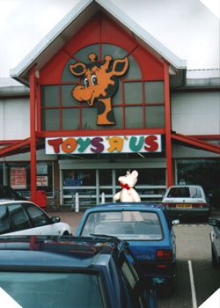
Second Half of the 18th Century
Change in the attitudes of family due to the increased survival rate of children
Shops were opened for children’s clothes for the first time
Primogeniture was no longer approved
Books, games, toys & puzzles were used to please and teach children of upper class society

Slide 34
Children
Caused peasants lots of anxiety because they were seen as more mouths to feed
Infanticide, though illegal became common
Unwanted children were taken to foundling institutions
  Became overburdened with children
  50-90% of all infants died here
Working class children, male & female, helped their parents or worked as servants in other households

Slide 35
Married Life
Began moving into their own houses
Nuclear families
  Achieved through later marriage ages – late 20s
  Later marriages also served as a natural form of birth control
  Most commonly used form of birth control was coitus interruptus

Slide 36
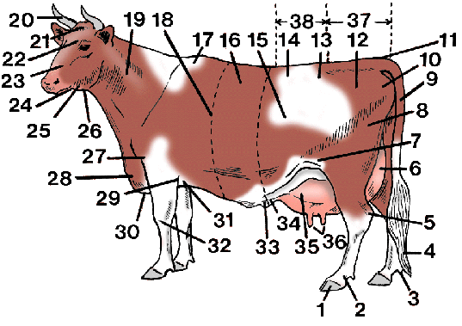
Agricultural Revolution
Increased food production occurred for four reasons
  More land under cultivation
  Increased crop yield
  Healthier & more abundant livestock
  Improved climate

Slide 37

Reasons Why
The “little ice age” declined
Land was left to lie fallow to renew it
  New crops like turnips restored nitrogen to the soil
  These crops served as food for livestock which created a larger number of animals

Slide 38
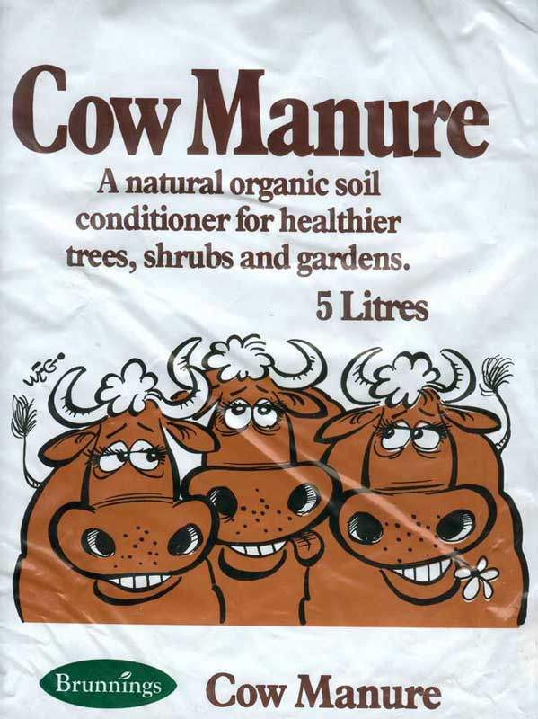
Livestock
Breeding produced stronger & more productive animals
More livestock meant more meat
  Helped people diets
  Animal manure was used as fertilizer
  This produced higher yields of crops

Slide 39

Jethro Tull
Suggested using a hoe to loosen soil to allow air and moisture to reach plants to allow them to grow better
Invented the seed drill to plant seeds in row rather than scattering them by hand

Slide 40

Potatoes & Corn
Produced higher crop yields with less effort
Brought to Europe through the Columbian exchange

Slide 41
Enclosure Movement
Large landowners kicked peasants off their land and consolidated all the small farms into one bigger & more productive farm
Peasants and tenant farmers moved to the cities and would become a valuable workforce in the near future
England became the leader of the agricultural revolution and increased productivity allowed them to focus on a the revolutionary idea of industrialization

Slide 42
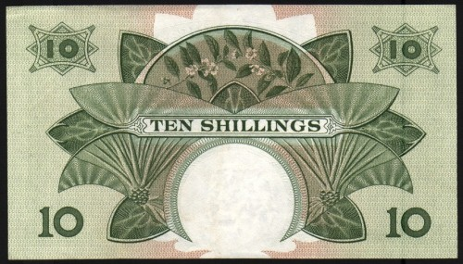
New Methods of Finance and Industry
The decline in the supply of gold and silver led to the acceptance of bank notes in order to expand credit

Slide 43
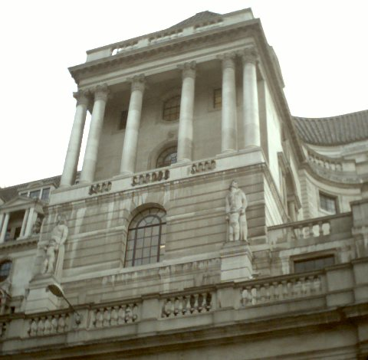
Bank of England
Different than other banks at the time
  Not only received deposits and exchanged foreign currency, but that they made loans
When the bank lent the government money, the bank could issue paper money instead of gold and silver

Slide 44
Bank of England
A distinction between national debt and the monarch’s debt occurred
Public confidence in this new system
  Allowed Britain to borrow lots of money at low interest rates
  Gave it an advantage over other European countries

Slide 45
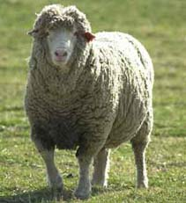
Textiles
The biggest industry was still textiles
  75% of Britain’s exports
Textiles were produced throught the Putting Out System

Slide 46
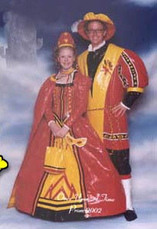
Putting Out System
Merchants would buy raw materials
Take them to the countryside where workers would weave them into cloth
Then the merchants would sell them in order to make a profit and manufacture more

Slide 47
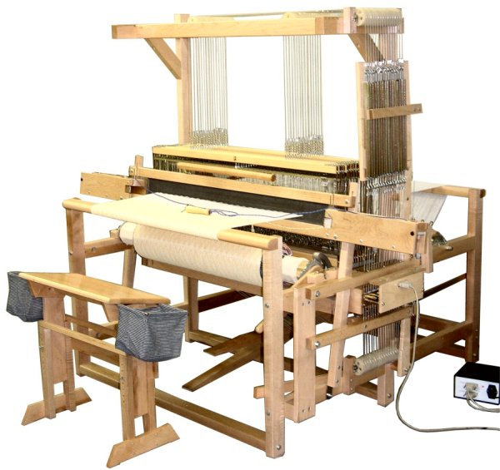
Industrial Beginnings
The importation of cotton, new methods and new machines saw the beginnings of the industrial revolution
New inventions like the flying shuttle, water frame and mechanized looms would later caused the destruction of the cottage industry

Slide 48
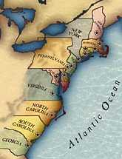
Global Economy
France’s inability to populate North America allowed the British to gain the upper hand
Created 13 colonies that acted independently and resisted regulations from the British

Slide 49
Mercantilism
The colonies still had to follow the rules of mercantilism
  Providing raw materials to Britain
  Buying manufactured goods from Britain
The balance of trade was in favor of the mother country (Britain)

Slide 50
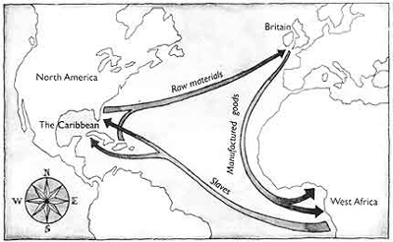
Triangle Trade
A global economy emerged with the triangle trade
The most profitable goods were African slaves

Slide 51
The Social Order
Social status was still determined by traditional orders of heredity
  Enlightenment intellectuals attacked these but they were not ended either
Prussian law forbade marriage between nobles and the middle class
The old order would not end until the French Revolution

Slide 52
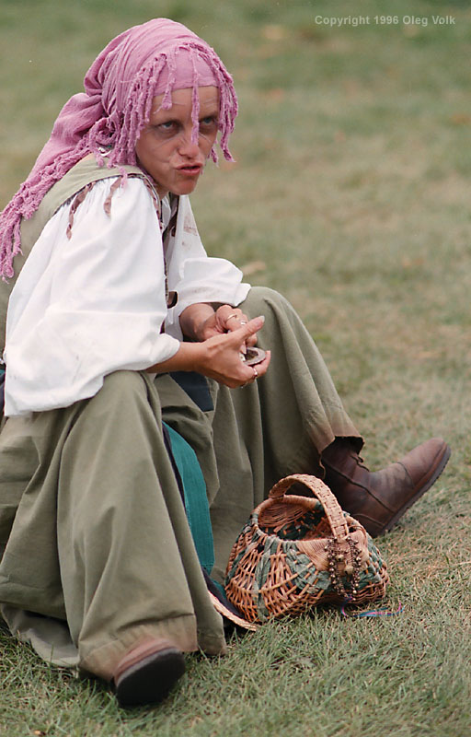
Peasants – Western Europe
Peasants were mainly rural and made up 85% of Europe’s population
Western Europe
  Most were tenant farmers that had to pay tithes (1/3 of crops in taxes)
  Deal with aristocrats hunting on peasant land
  Paid fees

Slide 53
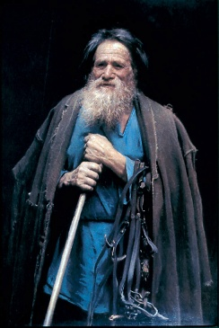
Peasants – Eastern Europe
Most were serfs that were bound to the estate
  Had to perform labor
  Couldn’t move or marry without permission or the payment of a special tax
In Russia most were serfs that resembled slavery

Slide 54
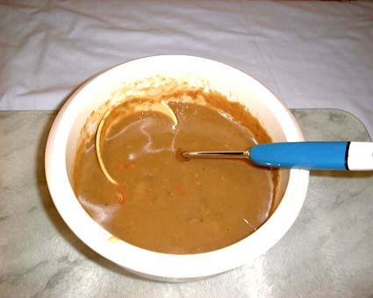
Peasants
Diets consisted of dark bread that was high vitamin, minerals & protein, water, beer, wine, soup and gruel
Later potatoes & corn
Famine still occurred which made them more susceptible to disease

Slide 55
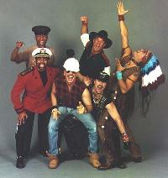
Villages
Were the center of social life
Maintained order, provided relief to the poor, had a church, a school, maintained roads & bridges and collected taxes for the government
Controlled by the rich peasants

Slide 56
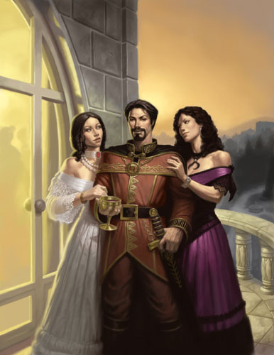
Nobility
2 to 3 percent of the population
Born noble, placed at the top of the social order and were given special privileges & rights
  Exemption from taxes, immunity from severe punishment

Slide 57
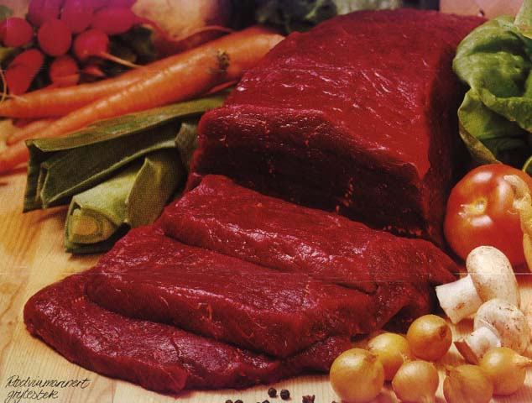
Nobles
Sometimes made money from exploiting the raw materials found on their estates
Consumed large amounts of meat, fish, cheese, nuts and sweets
Made up the important ranks of the military and government

Slide 58
Country Estates
Majority of aristocratic landowners lived at their country estates
  Fulfilled their desire for privacy while still allowing them to carry on public activities
Upstairs rooms were for sleeping, private activities and playing with the children
  Servants were housed in their own section of the estate and were called upon with a system of bells
They would also have houses in the city for seasonal visits

Slide 59
Travel
The Grand Tour of Europe, was essential for the sons of aristocrats to complete their education
Travel was difficult across the English Channel due to rough seas, over the Alps due to narrow passes, across the Mediterranean due to pirates and at Inns due to thieves and bed bugs

Slide 60
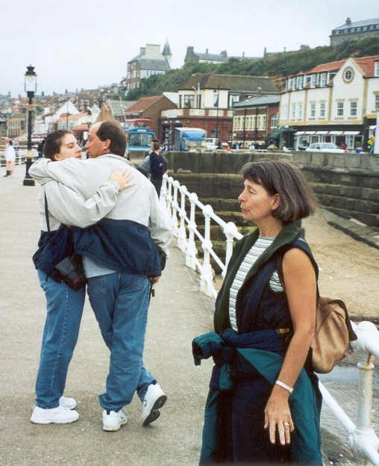
The Grand Tour
Because of its educational purposes, students were accompanied by tutors to ensure they would go to museums and galleries instead of pursuing, wine, women and songs

Slide 61
Cities
Were the center of education, culture and prosperity but because of unsanitary living conditions and overcrowding, death rates remained high
  Rural peasants moved to the cities to find work as unskilled laborers, but there was rarely work available for them
  Poverty increased, and people often became beggars or prostitutes to get by

Slide 62
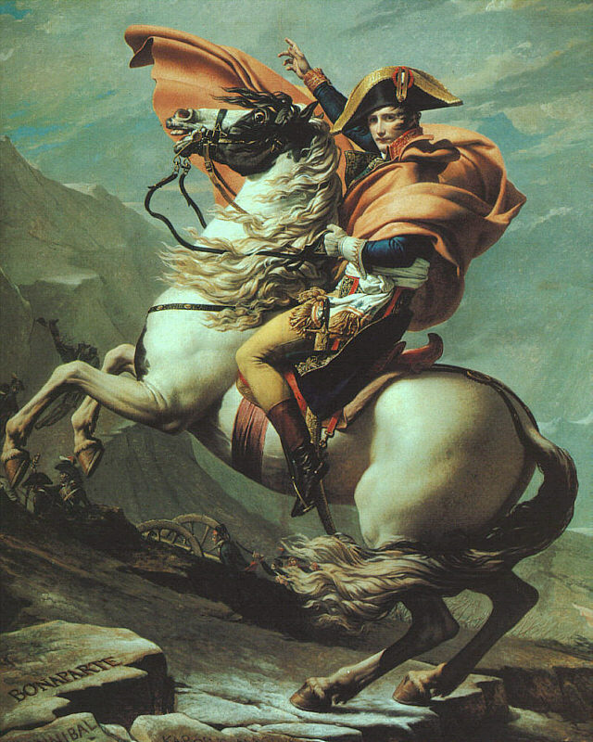
Up Next – The French Revolution

