Slide 1
Revolution in Haiti
Francois-Dominique Toussaint L’Ouverture – former slave leads slave revolt against white Frenchman and freed mulattos (1791)
1793 – France abolishes slavery in Haiti
1800 – L’Ouverture makes himself Governor-General for life and continues ties to France
1802 – Napoleon tries to keep Haiti for France
1804 – Napoleon, busy at war with Britain, gives Haiti its independence

Slide 2
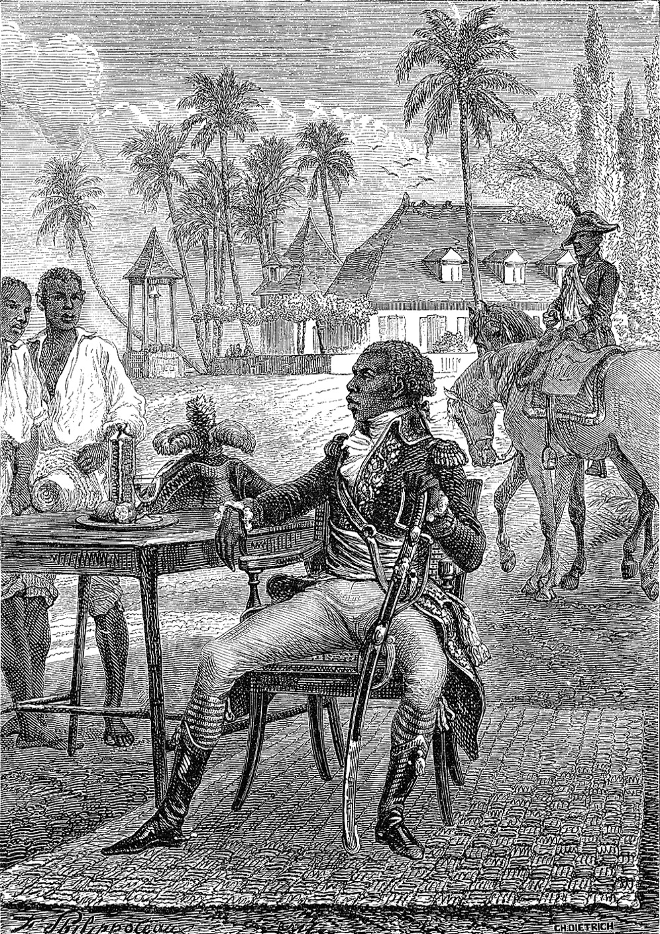
Notes:
Toussaint L’Ouverture (1746–1803) began the revolt that led to Haitian independence in 1804.
Stock Montage

Slide 3
Creole Discontent
Creoles – persons of Spanish descent born in the South American colonies
Creoles resented the peninsulares – white people who were born in Spain, who seemed to get all the political advantages
When Latin American countries won their independence, creoles received equal rights

Slide 4
Two South American Independence Leaders
Jose de San Martin – led independence movements in Chile and Peru, later becoming Protector of Peru
Simon Bolivar – independence leader of Venezuela / later leads fight at Battle of Ayacucho, which ends Spain’s control in Latin America

Slide 5
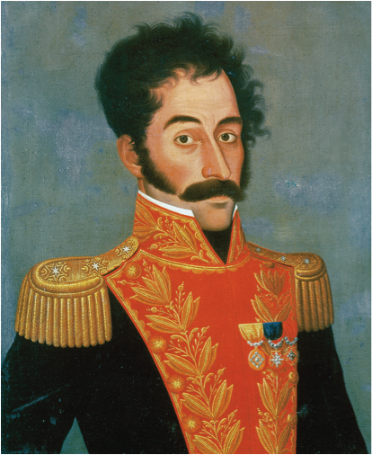
Notes:
Simón Bolívar. Bolívar was the liberator of much of Latin America. He inclined toward a policy of political liberalism.
© Christie’s Images/CORBIS

Slide 6
New Spain
Area from what is now the Southwest United States to Mexico
Battle of philosophies between conservative Spanish and Creole groups and the liberal monarchy of Spain
Augustin de Iturbide declares Mexico independent from Spain in 1821 and is declared emperor

Slide 7
Brazilian Independence
Dom Pedro becomes emperor of an independent Brazil in 1822
Peaceful revolution makes Brazil independent from Portugal
Political and social elites in Brazil wanted to avoid destructive wars
Slavery preserved

Slide 8
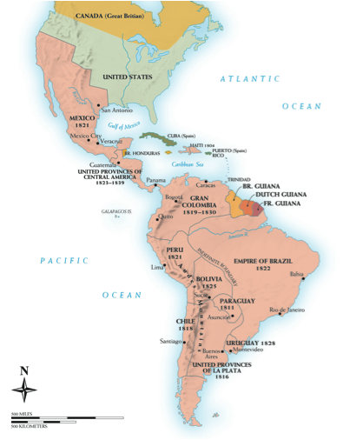
Notes:
Map 20–1 LATIN AMERICA IN 1830 By 1830 most of Latin America had been liberated from Europe. This map shows the initial borders of the states of the region with the dates of their independence. The United Provinces of La Plata formed the nucleus of what later became Argentina.

Slide 9
Suppression and Revolt in Russia
Unrest in the Army
Southern Society – led by Pestel, called for the end of serfdom, a representative government and independence for Poland
Northern Society – favored constitutional monarchy and the end of serfdom
Decembrist Revolt – when Nicholas becomes tsar after Alexander I, some army officers refuse to swear allegiance to him / the revolt is put down violently
Rule of Nicholas I – very little reform, still had serfdom, presence of secret police
Official Nationality
Russian Orthodox Church provides basis for morality, education, and intellectual life
Unrestrained power of the tsar
Polish Uprising – Poland’s independence movement in 1832 repressed by Nicholas I, who issues Organic Statute – declaring Poland an integral part of Russian empire

Slide 10
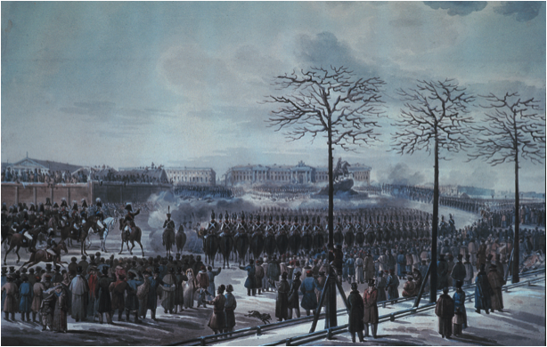
Notes:
When the Moscow regiment refused to swear allegiance to Nicholas, he ordered the cavalry and artillery to attack them. Although a total failure, the Decembrist Revolt came to symbolize the yearnings of all Russian liberals in the nineteenth century for a constitutional government.
“The Insurrection of the Decembrists at Senate Square, St. Petersburg on 14th December, 1825” (w/c on paper) by Russian School (19th century). Private Collection/Archives Charmet/Bridgeman Art Library

Slide 11
More Revolution in France
Charles X
Paid sums of money to aristocrats who lost land in Revolution
Restored rule of primogeniture
Sacrilege punishable by death
Put in ultraroyalist cabinet in 1829 in response to liberals
In response to military victories in North Africa, Charles X issues The Four Ordinances:
Restricted freedom of the press
Dissolved liberal Chamber of Deputies
Limited franchise to wealthiest members
Called for new elections
Revolution of 1830 – Charles X abdicates throne, ending Bourbon Dynasty and putting more liberal government in charge

Slide 12
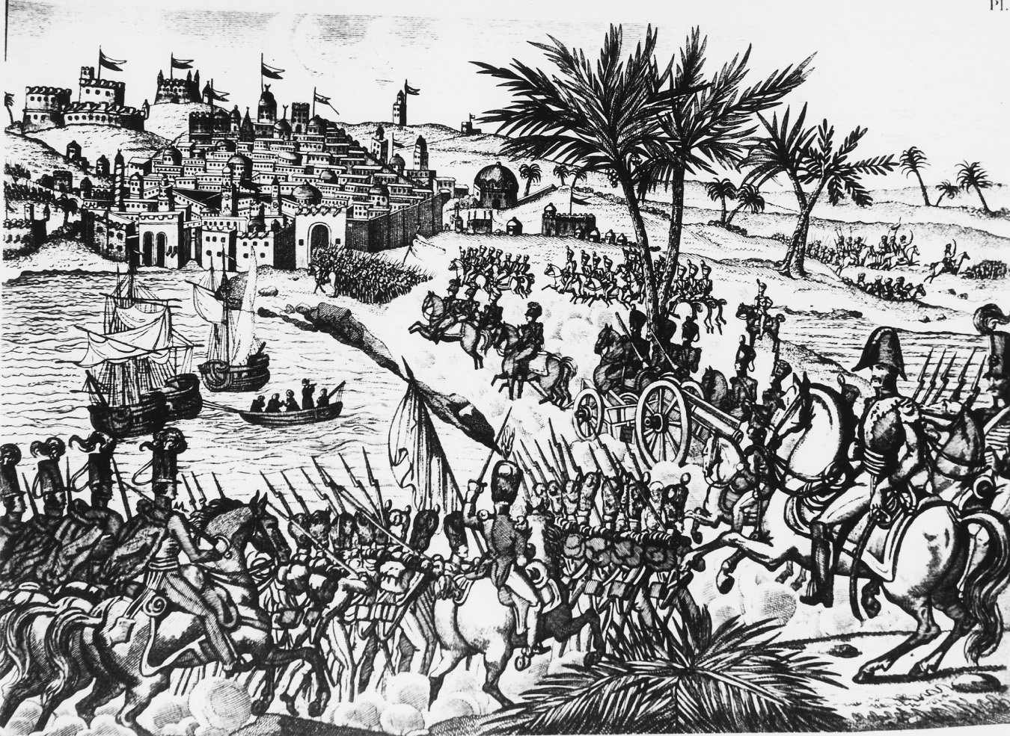
Notes:
On July 5, 1830 French forces captured Algiers, which France would continue to rule until 1962. Note how this drawing contrasts the power and modernity of the French conquerors with the almost medieval appearance of the Algerian defenses.
Roger Viollet/Getty Images, Inc.–Liaison

Slide 13
Louis Philippe
The monarchy under Louis Philippe was politically liberal
Freedom of religion
Freedom of press
But socially conservative
Little regard for lower classes
Revolts of working class put down violently
And expanded territories in North Africa

Slide 14
Independence for Belgium
Belgium becomes independent from Holland in 1830
British make sure Belgium’s independence is accepted as long as the new nation remains neutral in European affairs

Slide 15
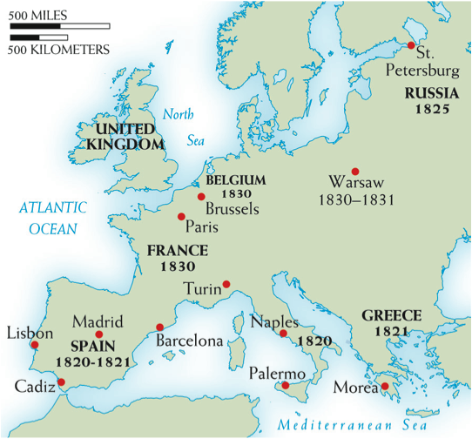
Notes:
Map 20–2 CENTERS OF REVOLUTION, 1820–1831 The conservative order imposed by the great powers in post-Napoleonic Europe was challenged by various uprisings and revolutions, beginning in 1820–1821 in Spain, Naples, and Greece and spreading to Russia, Poland, France, and Belgium later in the decade.

Slide 16
Reform in Britain
Lord Liverpool, although conservative, allows some reform such as greater economic freedom and permission for there to be labor organizations
Catholic Emancipation Act – allowed for Catholics to be in Parliament / passed to keep order in Ireland
Great Reform Bill – expanded size of England’s electorate, but did not eliminate property qualifications for voting or grant suffrage for women

Slide 17
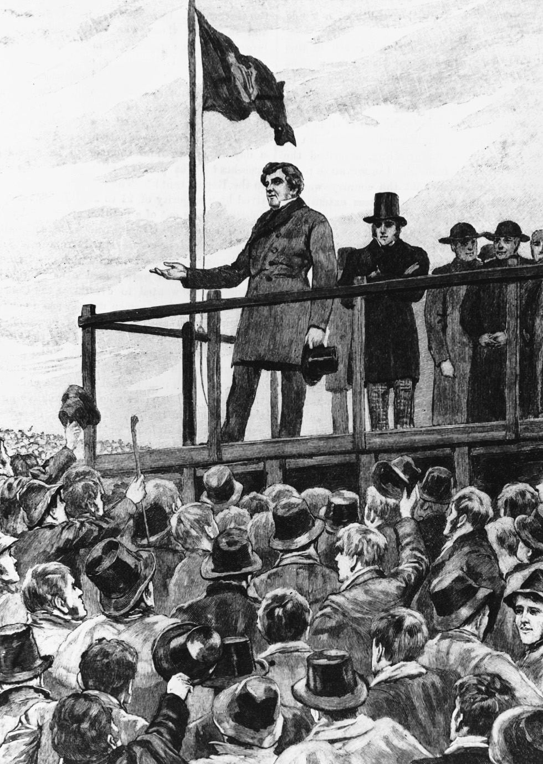
Notes:
Beginning in the l820s Daniel O’Connell revolutionized the organization of Irish politics. He created grass roots organization and collected funds to finance Irish nationalist activities. He was also known as one of the great public speakers of his generation. Here he is portrayed addressing a political gathering in County Meath, Ireland.
Getty Images Inc.—Hulton Archive Photos

