Slide 1
Chapter 20
The Conservative Order
and the Challenges of Reform (1815–1832)

Slide 2
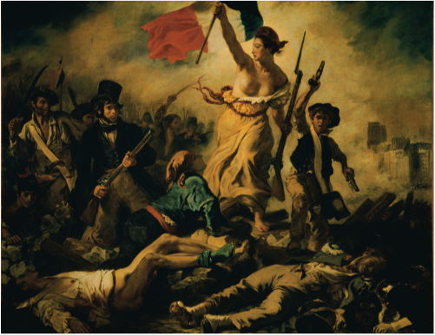
Notes:
In 1830, revolution again erupted in France as well as elsewhere on the Continent. Engène Delacroix’s Liberty Leading the People was the most famous image recalling that event. Note how he portrays persons from different social classes and occupations joining the revolution led by the figure of Liberty.
Eugene Delacroix (1798–1863), “Liberty Leading the People,” 1830. Oil on canvas, 260 × 325 cm—RF 129. Louvre—Department des Peintures, Paris, France. Photograph © Erich Lessing/Art Resource, NY

Slide 3
Nationalism
Nationalism – people are brought together by common bonds of language, customs, culture, and history
Developed in Europe in late 18th and early 19th centuries

Slide 4
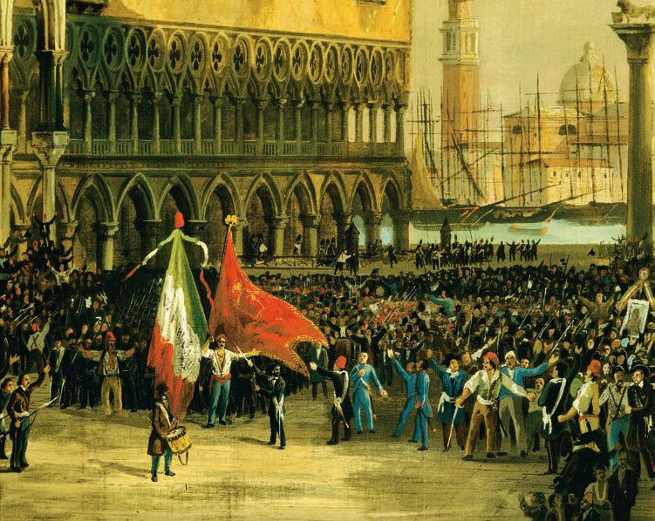
Notes:
During the revolutionary months of 1848, Italian nationalists unfurled the tri-colored green, white and red Italian nationalist flag on St. Mark’s Square in Venice to replace the flag of Austria, which then ruled the city. Austrian rule of Venice only ended in 1866.
Picture Desk Inc., Kobal Collection

Slide 5
Vienna Settlement Opponents
Nationalists felt nations should be based on ethnicity, not monarchies and dynasties (Congress of Vienna) as basis for national unity
Nations based on qualities of people not rulers
Confusion, though, because of minority groups

Slide 6
National Languages
Nations created based on unifying languages
National languages replaced local dialects

Slide 7
Meaning of Nationhood
Some people argued nationalism was based on eliminating dynastic states and having administrative and economic efficiency
Others argued nations created and kept on the basis of the divine order of things
Not all ethnic groups ended up becoming nations, as you needed to be large enough to establish an economy

Slide 8
Nationalistic Pressure
Nationalists challenged political status quo in six different European areas:
England brought Ireland under British rule in 1800, causing problems for two centuries
Germany pitted Austria and Prussia against one another
Italy sought to take over Italian peninsula from Austria
Poland struggled with Russia over independence
Eastern Europe – Hungarians, Czechs, and Slovenes sought independence from Austria
Serbs, Greeks, Albanians, Romanians, and Bulgarians sought independence from the Ottomans and Russians
In each area, nationalistic feelings ebbed and flowed

Slide 9
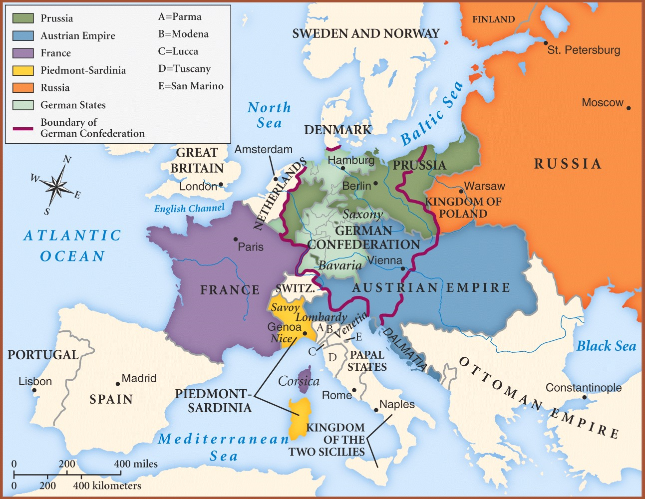

Slide 10
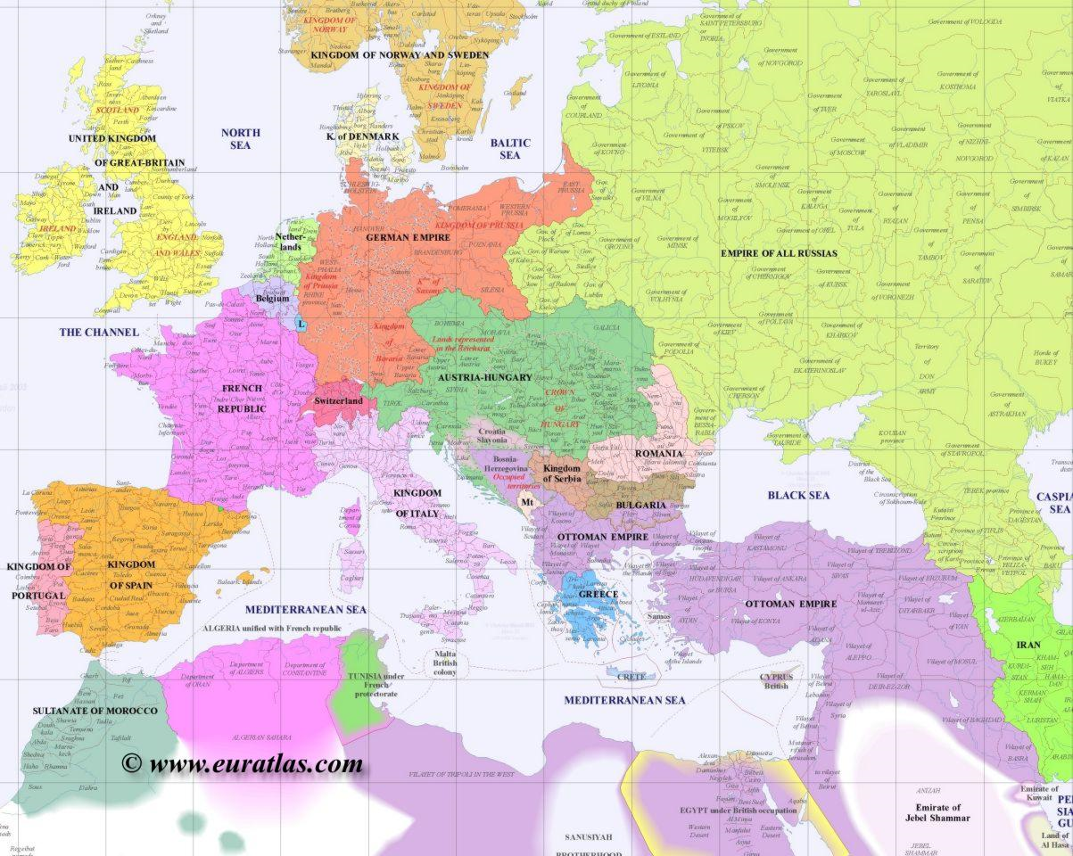

Slide 11
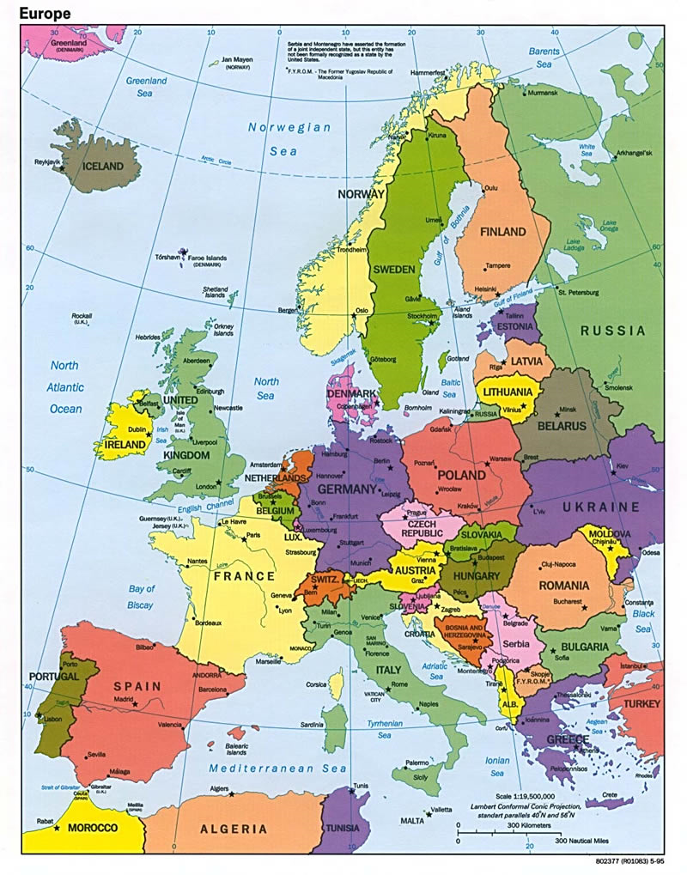

Slide 12
Early 19th Century Liberals
Political Goals – liberals were usually educators or wealthy, excluded from the political process; looked for:
Legal equality
Religious toleration
Freedom of the press
Written constitutions
Economic Goals
Wanted free trade
Less government regulation
Relationship of Nationalism to Liberalism
Opposition
Nationalists wanted to dominate particular national or ethnic groups within a particular region
Compatible
Nationalists could gain liberal support by espousing their ideals (e.g. – Greece)

Slide 13
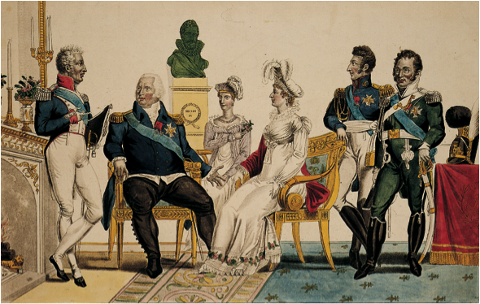
Notes:
The French Bourbons were restored to the throne in 1815 but would rule only until 1830. This picture shows Louis XVIII, seated, second from left, and his brother, the count of Artois, who would become Charles X, standing on the left. Notice the bust of Henry IV in the background, placed there to associate the restored rulers with their popular late-sixteenth–early-seventeenth-century forebearer.
Bildarchiv Preussischer Kulturbesitz

Slide 14
Conservative Outlooks
Conservative pillars were legitimate monarchies, aristocracies, and established churches
Did not want written constitutions
Disliked Enlightenment

Slide 15
Hapsburg Empire
Hapsburg nationalism in Austria felt threatened by a large number of different ethnic groups
Austrian Prince Klemens von Metternich – felt Austria had to dominate the German Confederation to keep it from developing its own constitution

Slide 16
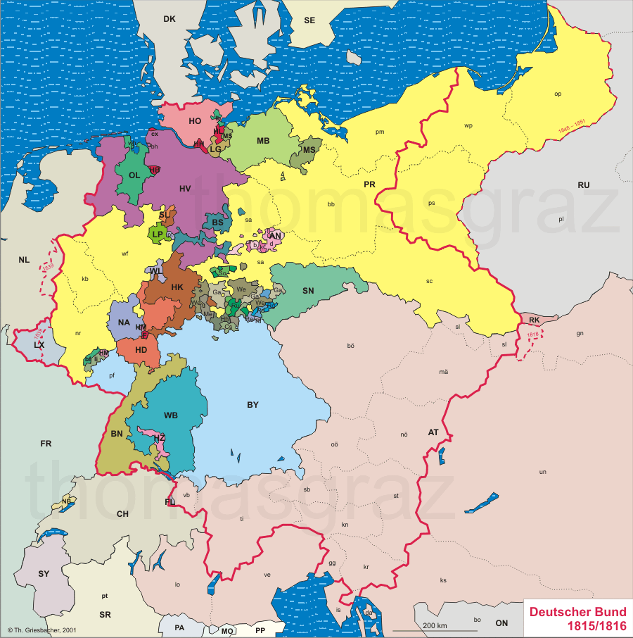

Slide 17
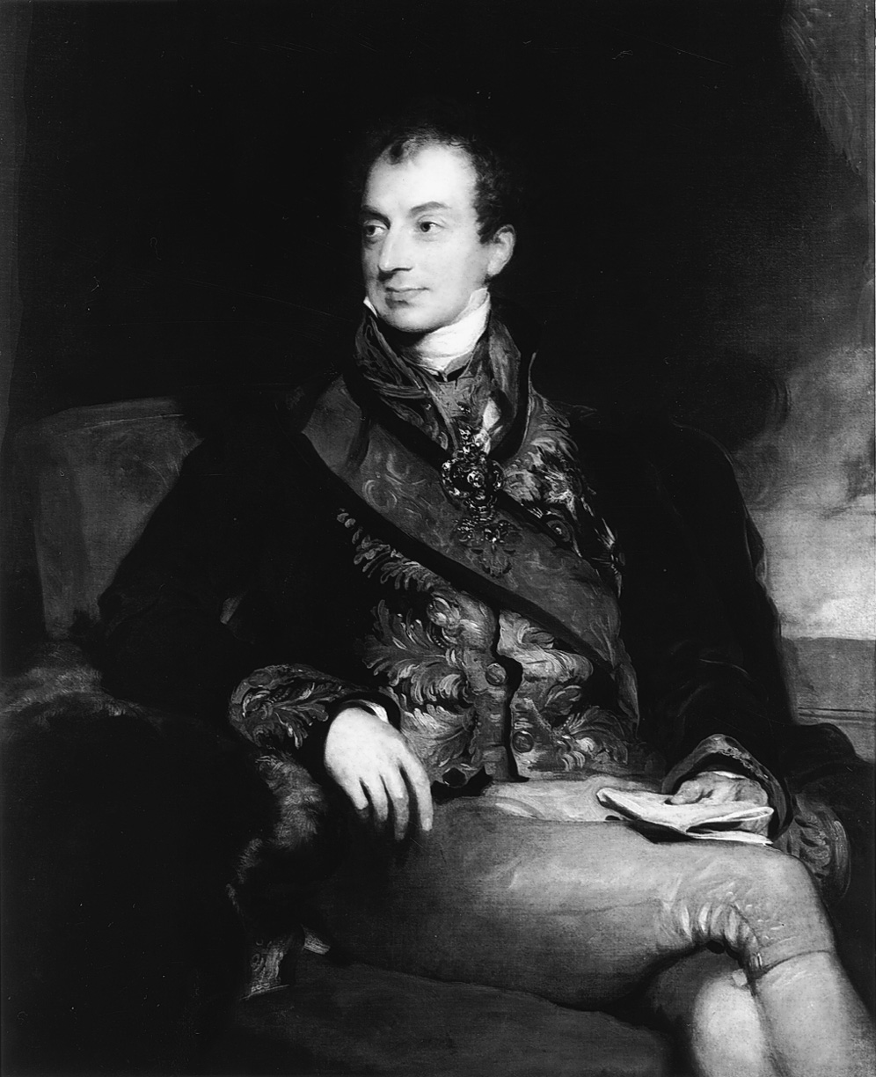
Notes:
Prince Klemens von Metternich (1773–1859) epitomized
nineteenth-century conservatism.
Sir Thomas Lawrence (1769–1830), “Clemens Lothar Wenzel, Prince Metternich” (1773–1859), RCIN 404948, OM 905 WC 206. The Royal Collection © 2003, Her Majesty Queen Elizabeth II

Slide 18
Defeat of Prussian Reform
Frederick William III – Prussian leader who created Council of State, which established eight provincial diets
Junkers dominated the diets, keeping the bond between the monarchy and the landholders

Slide 19
Burschenschaften and the Carlsbad Decrees
Burschenschaften – student association of German nationalists
Often Anti-Semitic
One member, Karl Sand, murdered dramatist August von Kotzebue and was summarily executed for the crime
Carlsbad Decrees – ordered by Metternich – dissolved the Burschenschaften

Slide 20
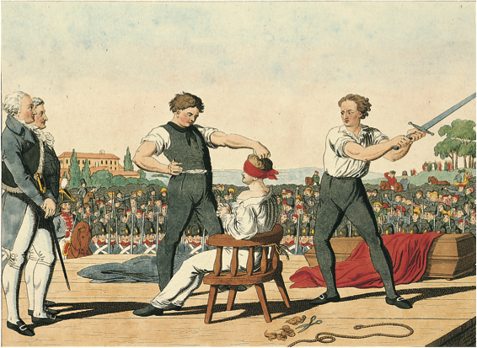
Notes:
In May 1820, Karl Sand, a German student and a member of a Burschenschaft, was executed for his murder of the conservative playwright August von Kotzebue the previous year. In the eyes of many young German nationalists, Sand was a political martyr.
Bildarchiv Preussischer Kulturbesitz

Slide 21
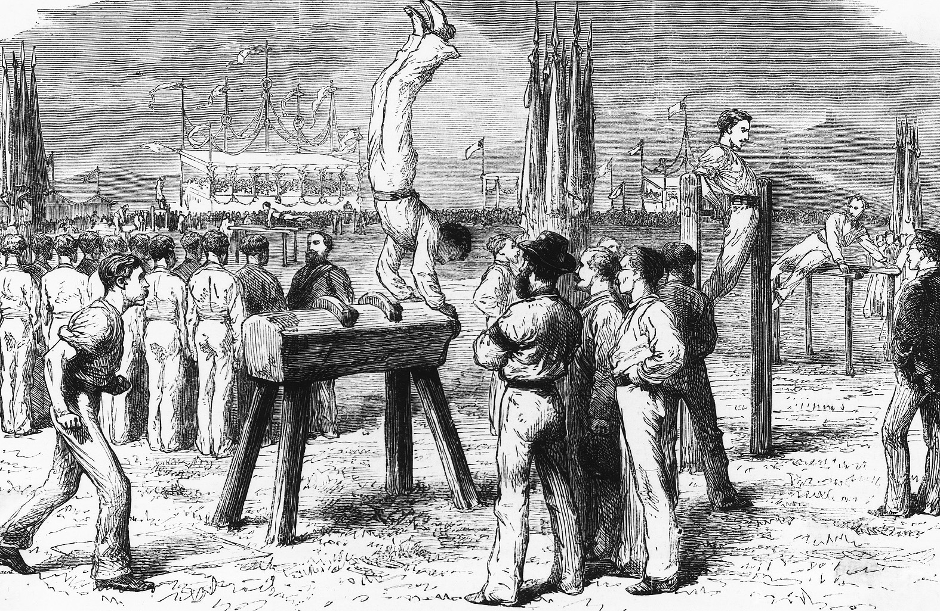
Notes:
Turnvater Jahn encouraged German gymnasts to use athletic equipment in their exercises. Here at a Bonn gymnastic festival of 1872 an athlete works out on a Pommel Horse, a piece of athletic equipment that pre-dated Jahn but the design of which he improved. Also note the athletic clothing which emphasizes egalitarian social relations among the athletes.
CORBIS/Bettmann

Slide 22
Postwar Repression in Great Britain
Lord Liverpool – sought to protect the interests of the wealthy
Corn Law – raised prices on corn
Excise and income tax – both wealthy and poor paid
Discontent from masses
Leaders of the low social orders called for changes
Had unruly mass meeting at Spa Fields near London
Liverpool, in response, passes Coercion Acts of 1817, which suspended habeas corpus and outlawed seditious gathering

Slide 23
Continued Repression in Great Britain
Peterloo Massacre – eleven radical protesters killed by militia at meeting in Manchester, England
Six Acts passed:
Forbade large, unauthorized meetings
Raised fines for seditious libel
Trials speeded up for political agitators
Increased newspaper taxes
Prohibited training of armed groups
Allowed local officials to search homes
Cato Street Conspiracy – plot by Radicals to blow up Cabinet failed

Slide 24
The Bourbon Restoration
Louis XVIII – becomes monarch in 1814 and agrees to be constitutional monarch
The Charter – provided for a hereditary monarchy and a bicameral legislature
Guaranteed most of the Declaration of the Rights of Man and Citizen
Religious toleration – but Roman Catholicism official language
Ultraroyalism – as revenge for the Revolution, royalists in the south and west of France practically drive the liberals out of politics and into a near illegal status

Slide 25
The Conservative International Order
The Concert of Europe – nations from the Congress of Vienna agree that one nation cannot take major action in international affairs without working with the others
The congress system – the Congress of Vienna removes troops from France after they had paid their war reparations
Tsar Alexander I of Russia wants to keep Quadruple Alliance and uphold existing borders
Castlereagh, representing Britain, feels Alliance was only to stop French aggression

Slide 26
The Spanish Revolution of 1820
Spain revolts against its monarch Bourbon Ferdinand VII
France, with permission from Austria, Prussia, and Russia, but not Britain, under the Congress of Verona, moves in to restore order and keep Bourbon Ferdinand VII in power
France gains land
English foreign minister, George Canning, attempts to stop further European colonization in Latin America by abiding by the Monroe Doctrine

Slide 27
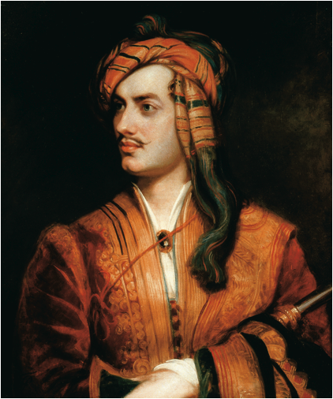
Notes:
An English Poet Appears as an Albanian The famous English poet, George Gordon, Lord Byron (1788–1824) was one of many European liberals who went to Greece to aid the cause of its independence. He died there of fever in 1824.
The Granger Collection, NY

Slide 28
Revolt Against Ottoman Rule
The Greek Revolution of 1821 – Greece revolts against Ottoman rule in 1821
Britain , France, and Russia conclude that an independent Greece would benefit strategic interests
Otto I is declared first king of the new Greek kingdom
Serbian Independence of 1830 – granted by the Ottoman sultan after years of revolts and fighting
Serbia comes under the protection of Russia in 1820s
1856 – officially under the protection of the great powers, but still has special relationship with Russia

